Slide 1

Analysis of Heart Failure dataset
Daniele Buschi
15 febbraio 2022

Slide 2
General purpose
What are the most important features which determines heart failures?

Slide 3
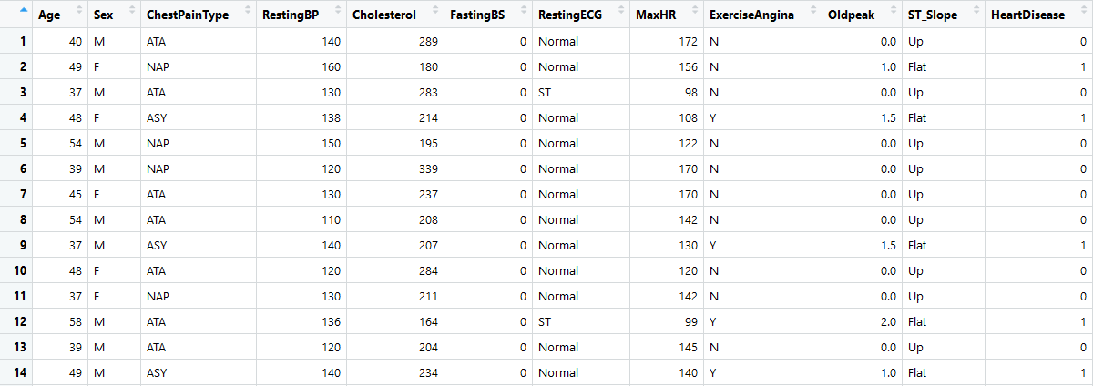
Overview of the dataset
Total dataset: 918 observations

Slide 4
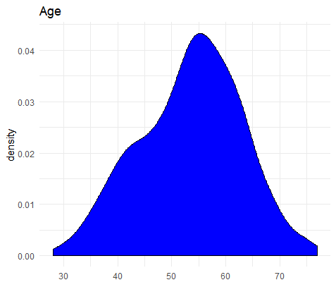
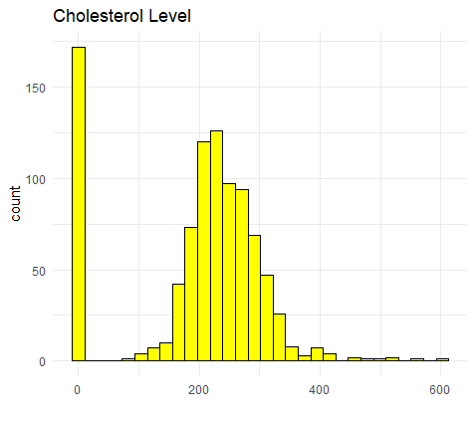
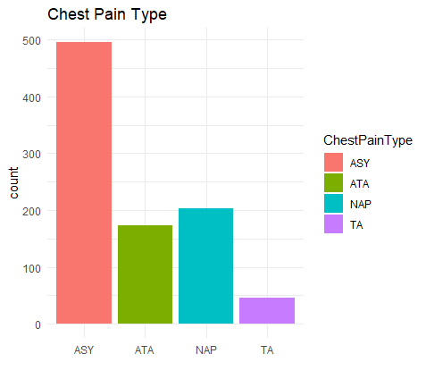
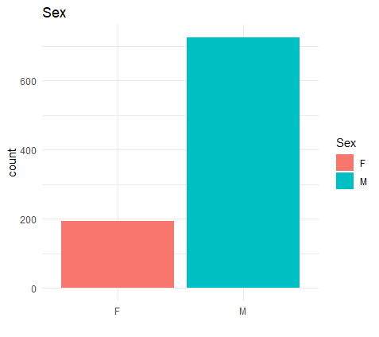
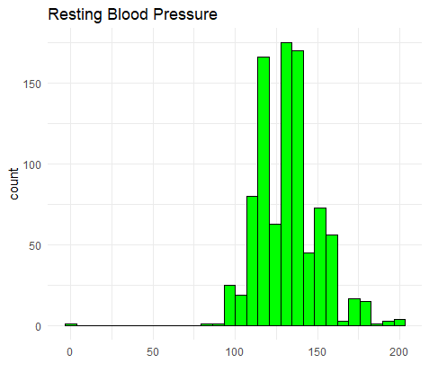
D
A
T
A
D
I
S
T
R
I
B
U
T
I
O
N
1

Slide 5
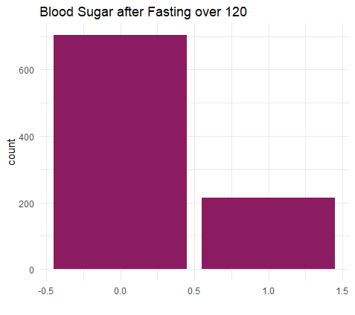
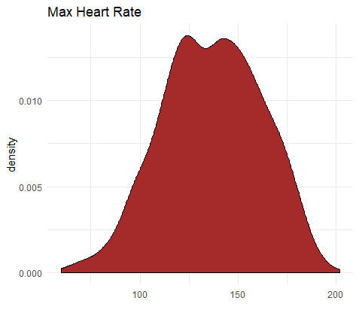
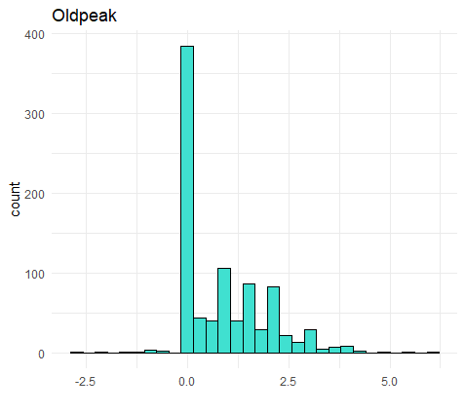
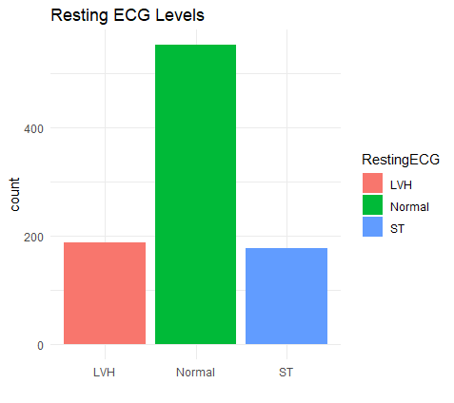
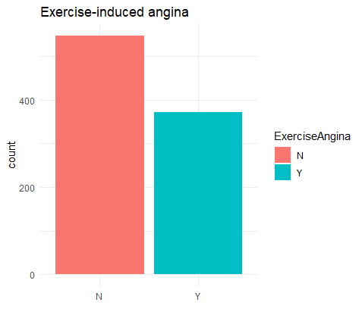
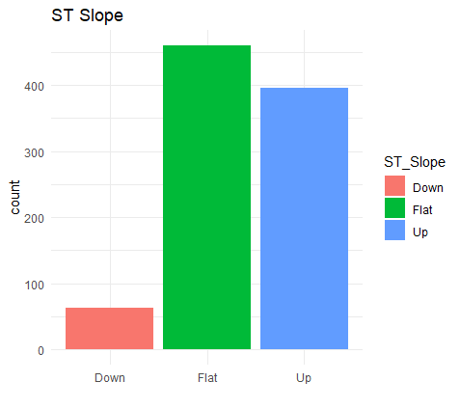
D
A
T
A
D
I
S
T
R
I
B
U
T
I
O
N
2

Slide 6
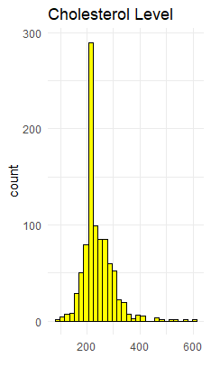
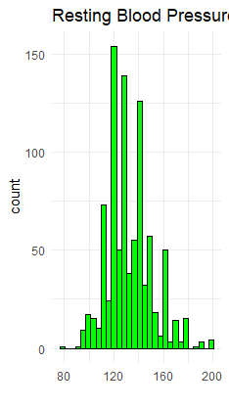
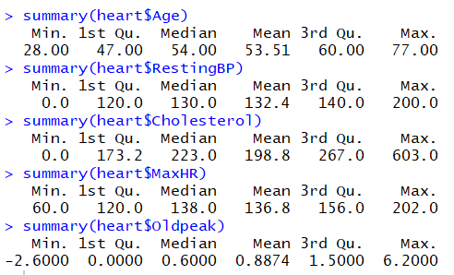
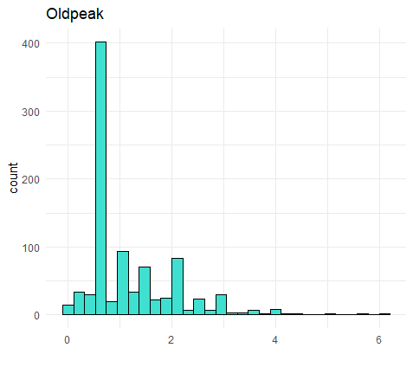
Corrections
Unreasonable data must be corrected substituting them with the mean values of the distributions.

Slide 7
B
E
F
O
R
E
A
F
T
E
R

Slide 8
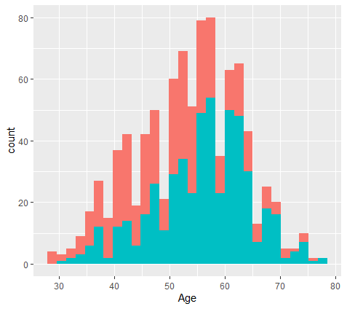
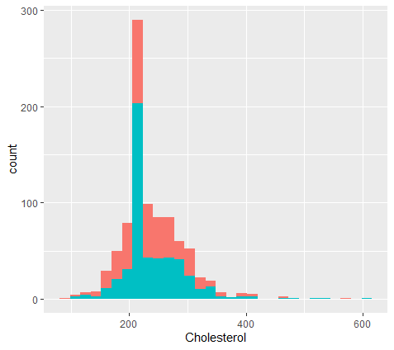
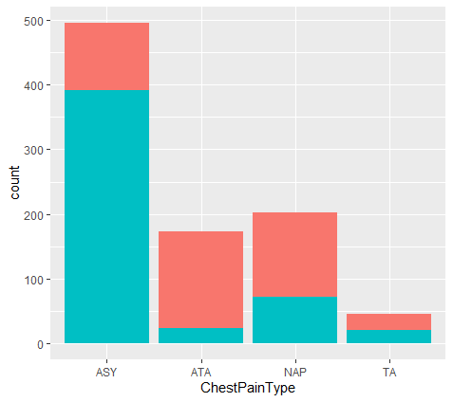
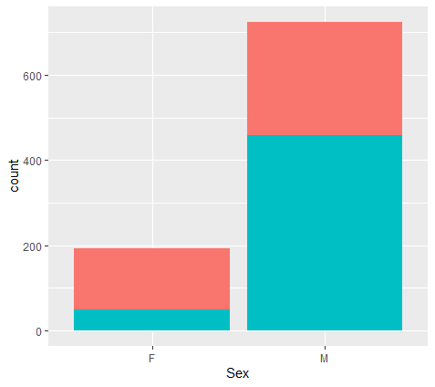
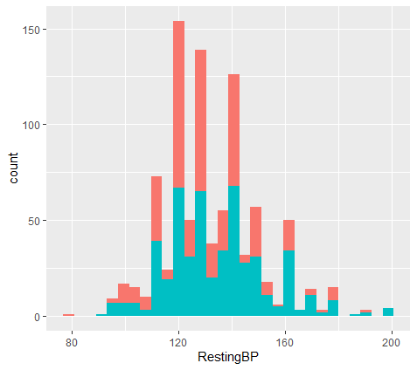
Distributions connected
with heart failure 1
= no heart failure
= heart failure

Slide 9
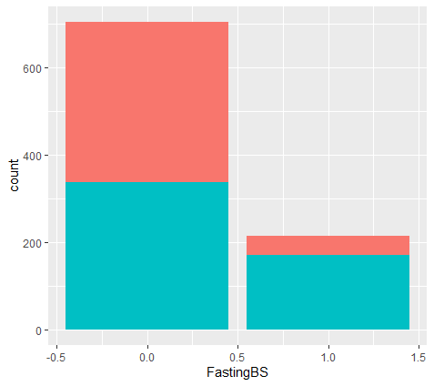
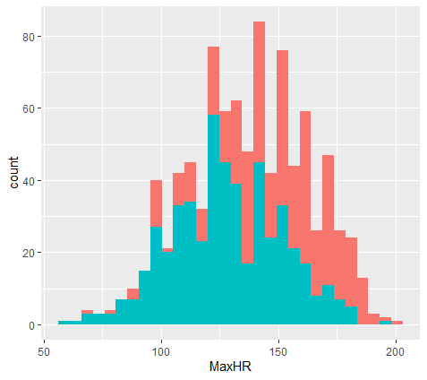
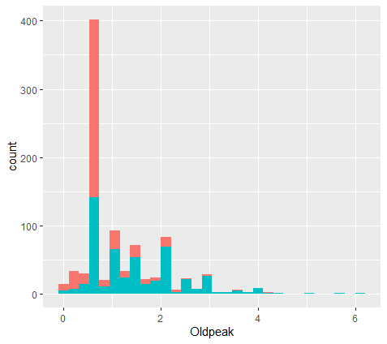
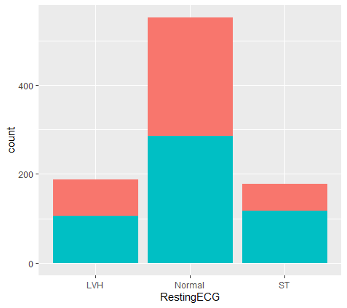
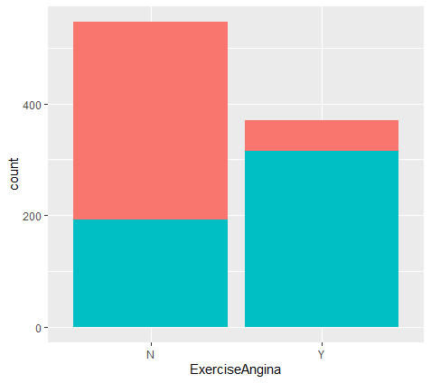
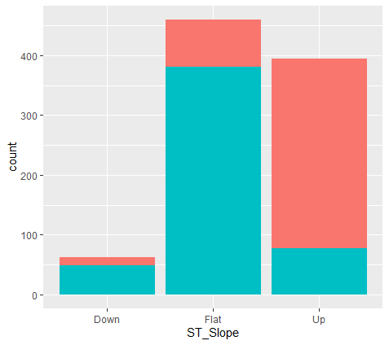
Distributions connected
with heart
failure 2
= no heart failure
= heart failure

Slide 10
Comparison between people with or without heart failure
Age → higher = more risk
Sex → males = higher risk
ChestPainType → ASY = high risk
FastingBS → >120 = high risk
MaxHR → lower = more risk
ExerciseAngina → Y = high risk
ST_Slope → Down / Flat = high risk
RestingECG, Oldpeak, RestingBP, Cholesterol → difference not too significant

Slide 11
Risorse umane diapositiva 2
Questions and relations
What is the relation between:
age – heart failure
sex – heart failure
chest pain type – heart failure
fasting blood pressure – heart failure
maximum heart rate – heart failure
exerciseAngina – heart failure
ST slope – heart failure

Slide 12
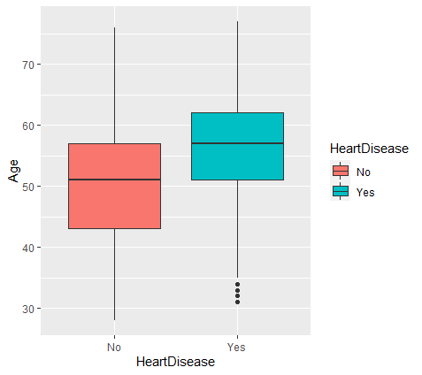
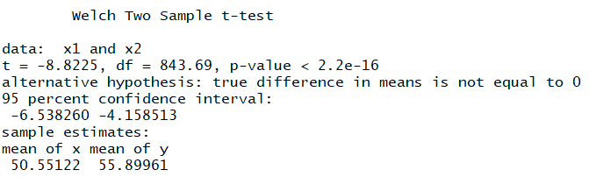
Age VS Heart Failure
Average age with disease = 55.9 y
Average age without disease = 50.5 y

Slide 13
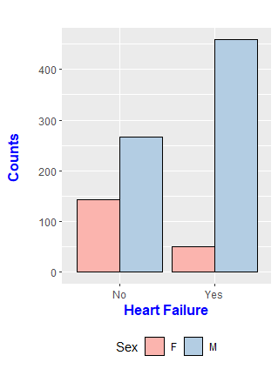

Sex VS Heart Failure
Is this difference statistically relevant?
Apply Pearson’s Chi-squared

Slide 14
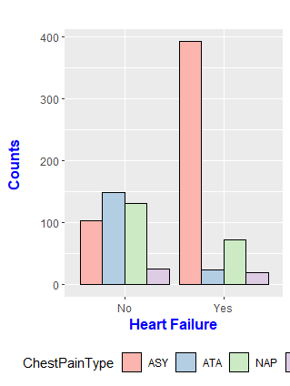

CheastPainType VS Heart Failure
Is this difference statistically relevant?
Apply Pearson’s Chi-squared
TA

Slide 15
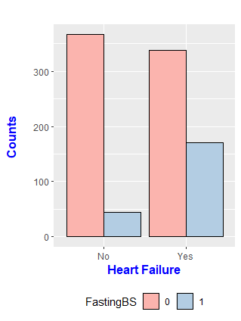

FastingBS VS Heart Failure
Is this difference statistically relevant?
Apply Pearson’s Chi-squared
TA
Threshold : 120mg/dl

Slide 16
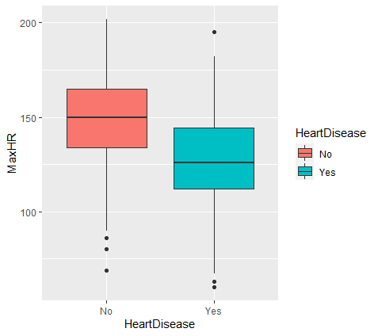
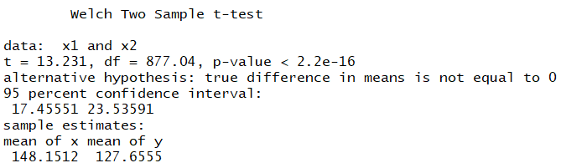
MaxHR VS Heart Disease
Average MaxHR with disease = 127.7 bpm
Average MaxHR without disease = 148.1 bpm

Slide 17
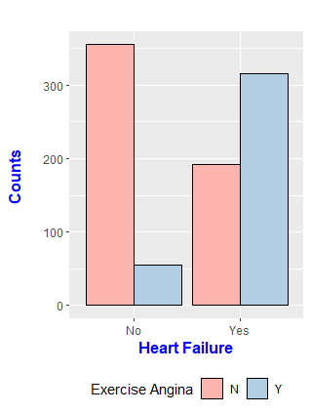

Exercise Angina VS Heart Failure
Is this difference statistically relevant?
Apply Pearson’s Chi-squared

Slide 18
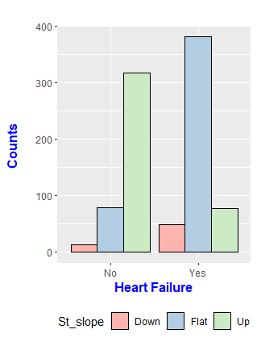

ST slope VS Heart Failure
Is this difference statistically relevant?
Apply Pearson’s Chi-squared

Slide 19
Risorse umane diapositiva 2
Modelling
After the tests the most relevant variables seems to be:
Sex , ChestPainType , MaxHR
and ST slope
Let’s check this results useing
Logistic Regression

Slide 20
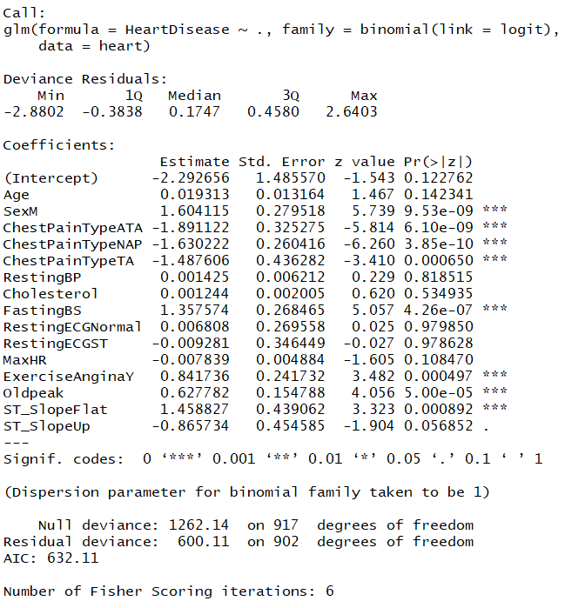
Logistic regression
As expected, the heart failures depend on:
Sex
ChestPainType
FastingBS
Exercise Angina
But different from our expectations «by eye»:
Oldpeak is significant (low tails masked it before)
MaxHR is not so relevant (the difference in the means are not so important to the model)

Slide 21
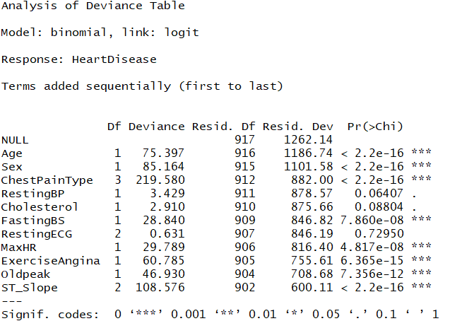
Anova
The differences between the null deviance and residual deviance shows how our model perform against null hypothesis.
The difference drops at each variable addiction meaning that it is significant for the model
The greater the distance in terms of Deviance is, the further is our model w.r.t «intercept only» hypothesis.

Slide 22
Risorse umane diapositiva 10
Thank you!
Daniele Buschi

